Slide 1

Bscpe 1-g Daily attendance and schedule using c

Slide 2
Members
Program overview
Flowchart
Video explanation

Slide 3
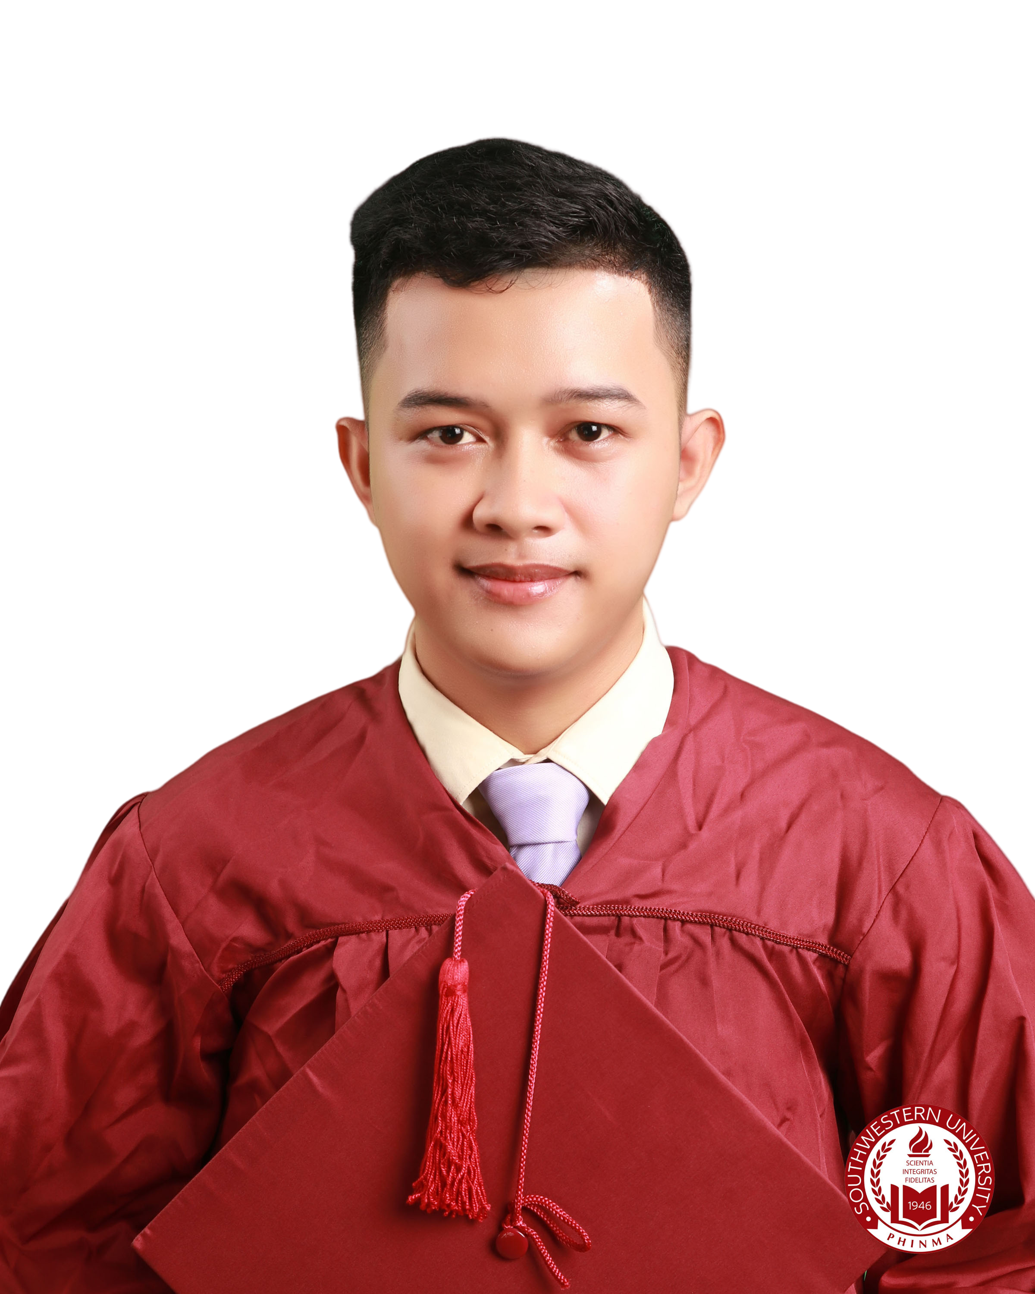
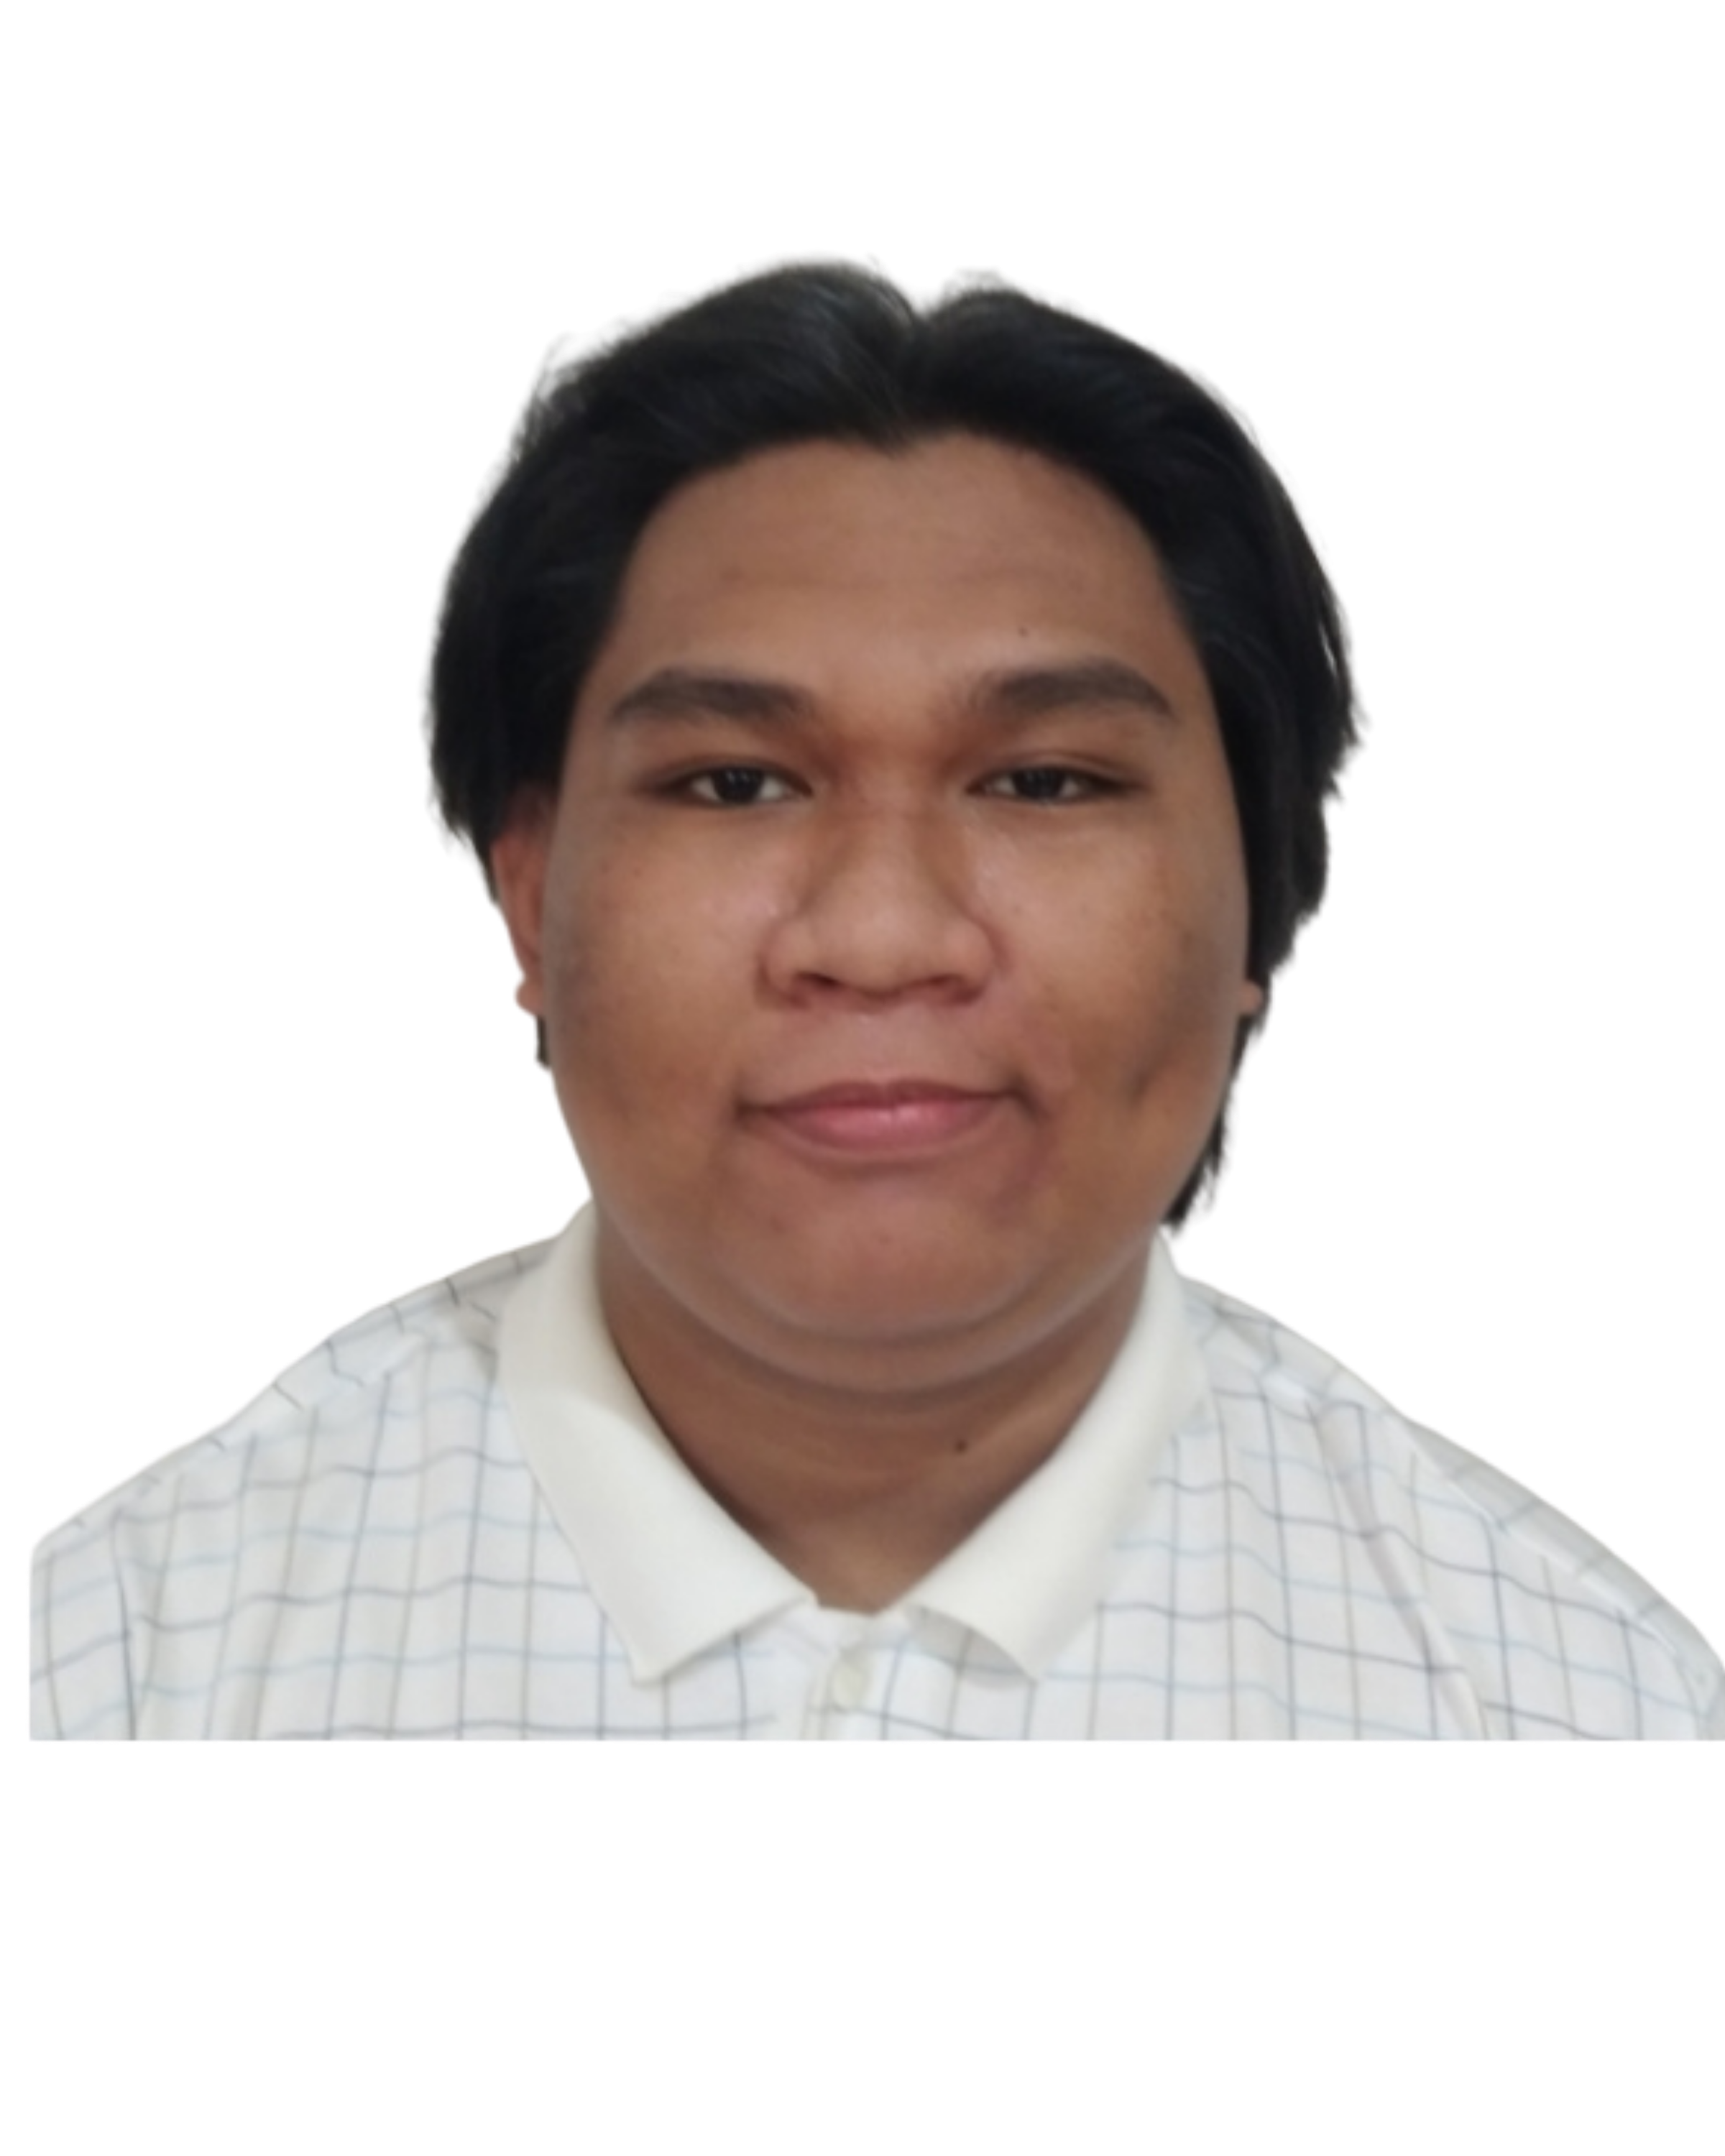
members
Ivan G. Suralta
ivan.suralta@ctu.edu.ph
Aldrin A. Felices
aldrin.felices@ctu.edu.ph

Slide 4
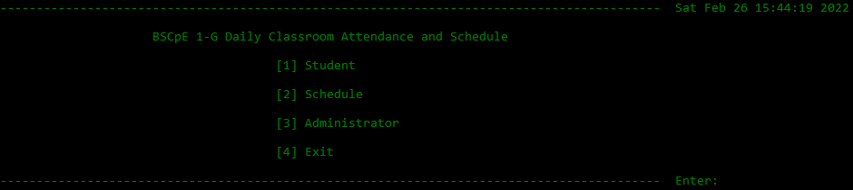
Program overview
This program is a classroom daily attendance checker. It collects first name and ID number from students. The administrator can access who timed-in base on the users input names and ID numbers. It also has a schedule page where users can check subjects and its time schedule.

Slide 5
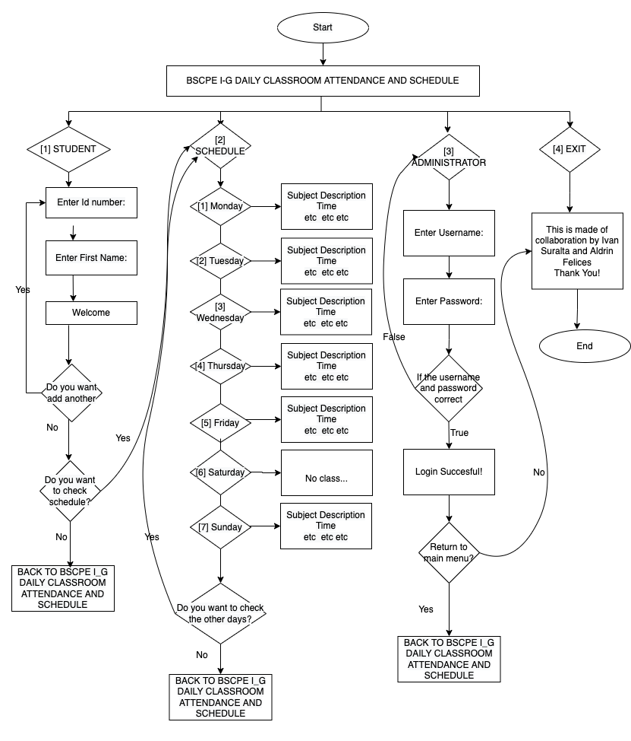
FLOWCHART

Slide 6
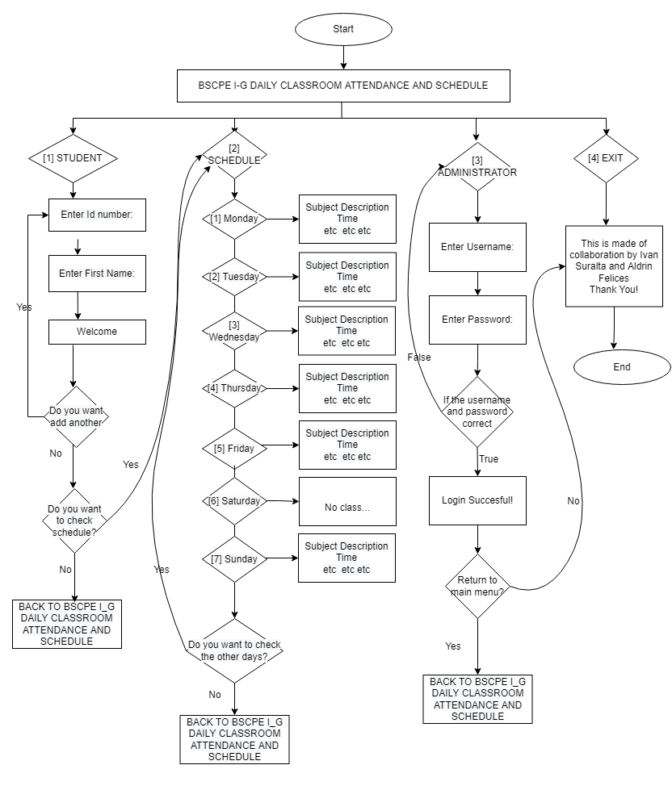

Slide 7
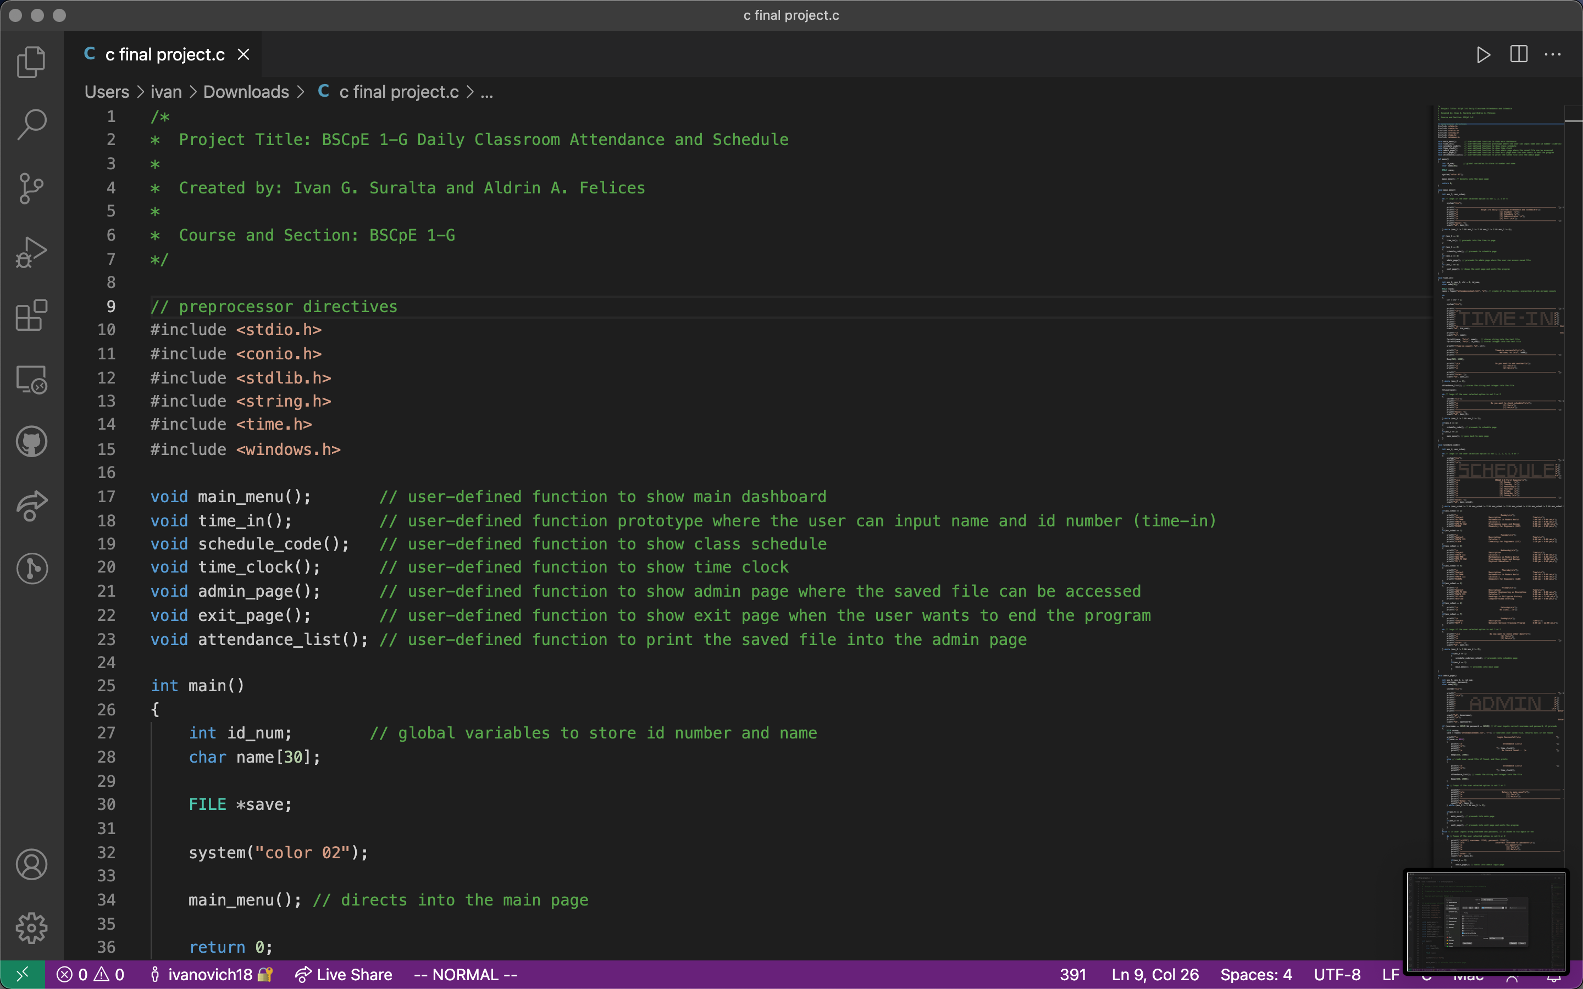
Video explanation

Slide 8
Thank You!

